Slide 1
This lesson includes the following sections:
    Monitors
    PC Projectors
    Sound Systems

Slide 2
Monitors
Categories of Monitors
CRT (Cathode Ray Tube) Monitors
Flat-Panel Monitors
Comparing Monitors
Video Controllers

Slide 3
Monitors - Categories of Monitors
Monitors are categorized by the technology they use:
Cathode ray tube (CRT) monitors
Flat-panel displays
CRT Types
Monochrome ( Black & White )-CRT monitor
Color -CRT monitor
CRT Display Controller Types
Monochrome Display Adapter(MDA)
Color Graphics Display Adapter(CGA)

Slide 4
Monitors - CRT Monitors
In CRT monitors, electrons are fired at phosphor dots on the screen.
The dots are grouped into pixels, which glow when struck by electrons.
In color CRTs, each pixel contains a red, green, and blue dot. These glow at varying intensities to produce color images.

Slide 5
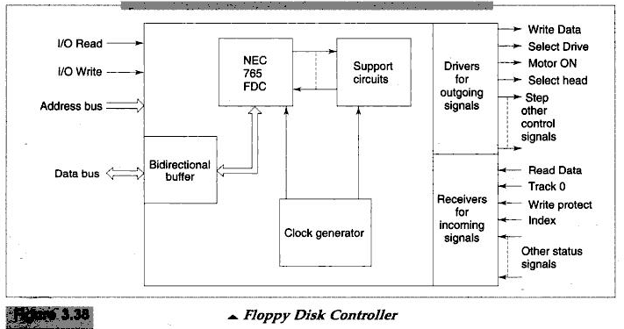
Floppy Disk Controller

Slide 6
Floppy Disk Controller
FDC Support upto four floppy disk drives
Connected to the system bus and the DMAS Controller
Based on the programmable IC,NEC 765 or 8272.
Its an intelligent floppy disk controller IC.
It converts data from parallel to serial .
It has logic to generate CRT character during writing on floppy disk an verify during reading.
FDP is capable to support different sector format and different speeds.
IBM Pc designed to support 5 ¼ inch 360 kb.

Slide 8
Monitors - CRT Monitors
In CRT monitors, electrons are fired at phosphor dots on the screen.
The dots are grouped into pixels, which glow when struck by electrons.
In color CRTs, each pixel contains a red, green, and blue dot. These glow at varying intensities to produce color images.

Slide 10
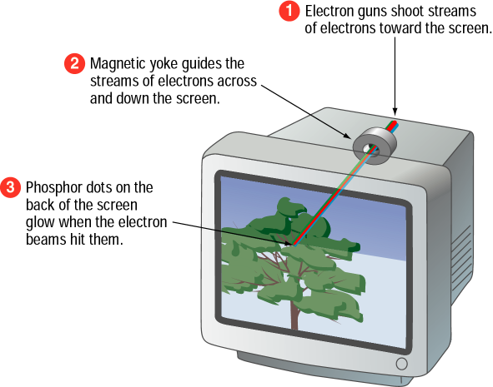

Slide 11
Monitors - Flat-Panel Monitors
Most flat-panel monitors use liquid crystal display (LCD) technology.
Passive matrix LCD uses a transistor for each row and column of pixels: less expensive, narrow viewing angle, submarining (animated graphics blurry)
Active matrix LCD uses a transistor for each pixel on the screen: expensive, wider viewing angle, faster refresh
Thin-film transistor (TFT) displays use multiple transistors for each pixel.

Slide 12
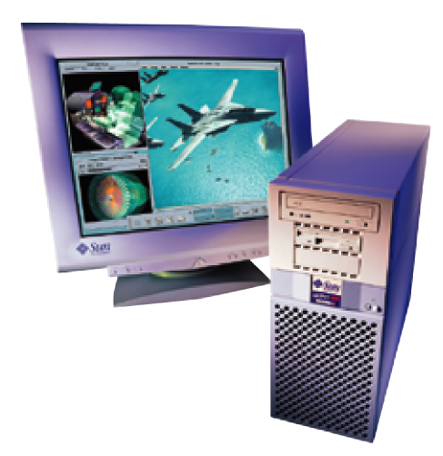
Flat-panel monitors take up less desk space;
less radiation

Slide 13
Monitors - Comparing Monitors
When comparing monitors, consider four features:
Size
Resolution
Refresh rate
Dot pitch

Slide 14
Comparing Monitors - Size
A monitor's size is the diagonal measurement of its face, in inches.
For years, 15" monitors (13"viewing area) were standard.
Today, 17" monitors (15" viewing area) are common.
Larger monitors are available, but can be expensive.

Slide 15
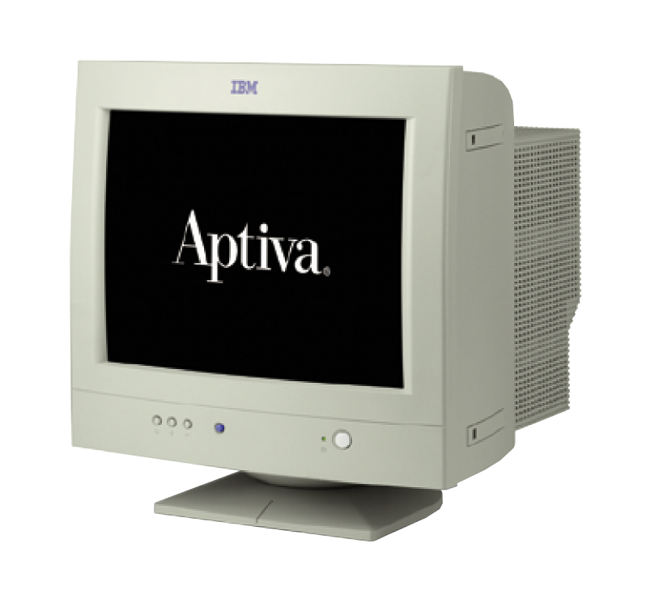
The diagonal
size (often 15”)

Slide 16
Comparing Monitors - Resolution
Resolution is the number of pixels on the screen, expressed as a matrix (such as 600x800).
A 17" monitor offers resolutions from 640x480 up to 1280x1024.
The Video Graphics Array (VGA) standard is 640x480. Super VGA (SVGA) monitors provide resolutions of 800x600, 1024x768 or higher.

Slide 17
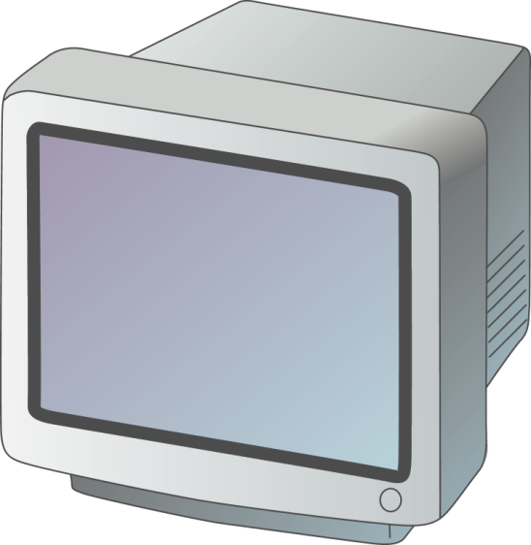

Resolution (image sharpness) is important.
  (Especially for graphics, page layout, and CAD (Computer Aided Design))

Slide 18
Comparing Monitors - Refresh Rate
Refresh rate is the number of times each second that the electron guns scan the screen's pixels.
Refresh rate is measured in Hertz (Hz), or cycles per second.
Look for a refresh rate of 72 Hz or higher. A slower rate may cause eyestrain.

Slide 19
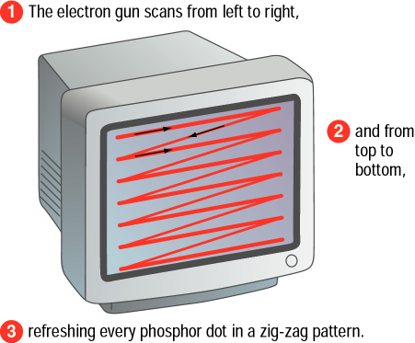
Fast scanning = Quick refresh (less flicker)

Slide 20
Comparing Monitors - Dot Pitch
Dot pitch is the distance between the phosphor dots that make up a single pixel.
In color monitors, three dots (red, green, and blue) comprise each pixel.
Look for a dot pitch no greater than .28 millimeter.

Slide 21
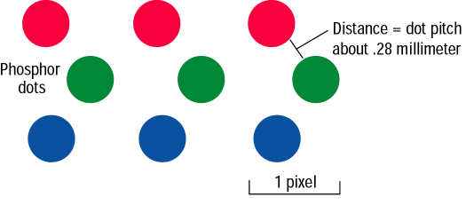
Fine dot pitch = Crisp displays

Slide 22
B + G
R + B
R + G
R + B + G
Phosphor Dot Color Mixing
R: Red, G: Green, B: Blue

Slide 23
Monitors - Video Controllers
The video controller is an interface between the monitor and the CPU (Central Processing Unit).
The video controller determines many aspects of a monitor's performance, such as resolution or the number of colors displayed.
The video controller contains its own on-board processor and memory, called video RAM (VRAM).

Slide 24
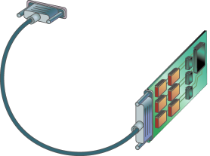
Video Control Board with Monitor Cable
VRAM
Graphic intensive applications such
as games require plenty of VRAM.

Slide 25
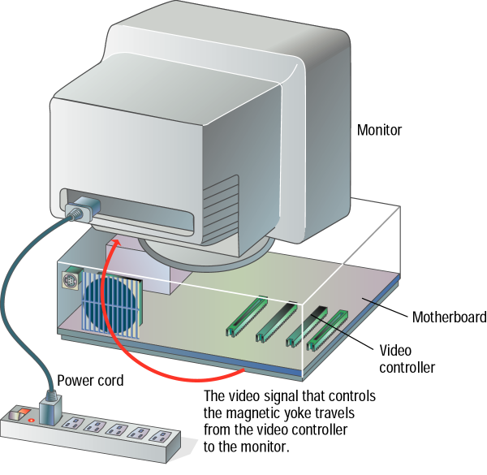

Slide 26
PC Projectors
A PC projector connects to a PC and is used to project images on a large screen.
Many PC projectors provide the same resolutions and color levels as high-quality monitors.
Digital light processing (DLP) projectors use a microchip containing tiny mirrors to produce very sharp, bright images.

Slide 27

Projected Screen

Slide 28
Sound Systems
Multimedia PCs come with a sound card, speakers, and a CD-ROM (Compact Disk-Read-Only Memory) or DVD (Digital Versatile Disk) drive.
A sound card translates digital signals into analog ones that drive the speakers.
With the right software, you can use your PC to edit sounds and create special sound effects.

Slide 29
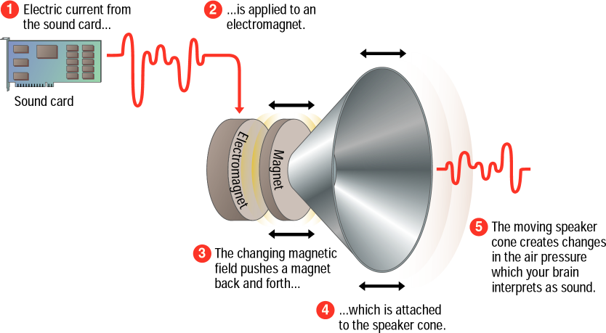

Slide 30
lesson 5 - Review
List the two most commonly used types of computer monitors.
Explain how a CRT monitor displays images.
Identify two types of flat-panel monitors and explain their differences.
List four characteristics you should consider when comparing monitors.
Explain how a computer outputs sound.

Slide 31
Project due Oct. 14
MIDI: Musical Instrument Digital Interface
Use MIDI to edit and play London Bridge or your favorite song.
For example: Mary has a little sheep: 3212 333 222 355 3212 333 22321.

